Slide 1


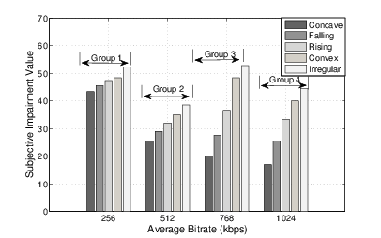



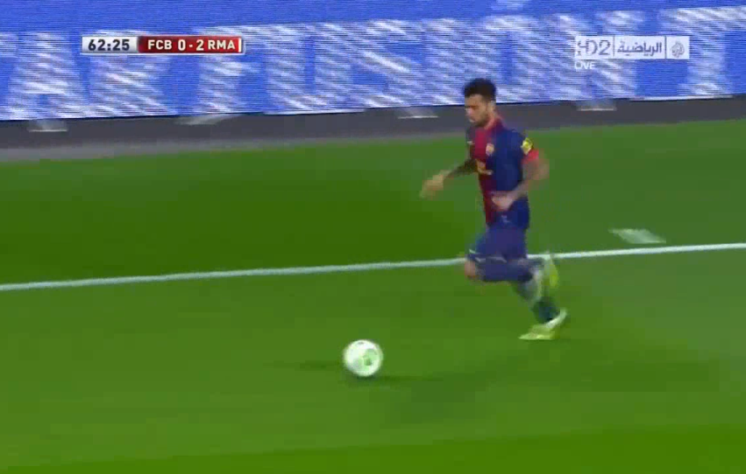
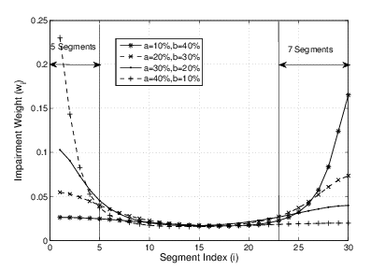
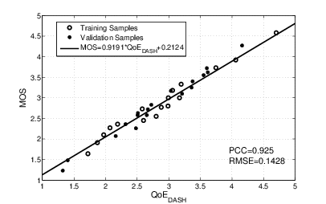
BUPT-QUALCOMM Joint Research Program
Study on DASH QoE Evaluation
Liu Hao, Shen Yun, Liu Yitong
Wireless Theories and Technologies Lab
Beijing university of Posts and Telecommunications, China
Email: liuyitong@bupt.edu.cn
Summary
Performance analysis
Performance of BUPT Model
Performance Validation of UCSD Model
Build BUPT QoE model of DASH service
Research 3 impairment factors on DASH service: Initial Delay, Stall, and Level Variation
107 video samples and 64 participants, more than 2800 votes received
Validate UCSD QoE model with BUPT subjective test results
More accurate than UCSD model with results both from BUPT and UCSD/Qualcomm
Propose a QoE model of level variation
Based on Primacy and Recency Effects
Identify level variation influence factors: Bitrate Switching, Bitrate Fluctuation Pattern
PCC : 0.9251 MSE : 0.0536
Performance is improved, even better in low motion scenario.
Result of UCSD Model
(Provided by UCSD)
PCC : 0.91
MSE : 0.082
Our Validation Result of UCSD Model
PCC : 0.7811
MSE : 0.1821
Subjective Impairment Tests
Subjective impairment tests under simulated environment
User Experience Impairment Factors
Influence factors:
Average bitrate
Bitrate fluctuation patterns:
Concave, Falling, Convex
Irregular: bitrate switches frequently with huge amplitude
Bitrate switching frequency
Videos provided by Qualcomm
Medium Motion Videos (BunnyCartoon and Movie)
High Motion Videos (Sports)
Impairment on bitrate fluctuation pattern
Video | Amount | Motion | Test Factors
BunnyCartoon_Stall_1-11 | 11 | Medium | Stall
Movie_Case01-48 | 48 | Medium | All factors*
Sport_Case01-48 | 48 | High | All factors
Primacy and Recency Effects
All factors*: stall, initial delay, and level variation
R = f(I_{ID}, I_{ST}, I_{LV})
Test 107 video samples and 64 participants
More than 2800 votes are received
Evaluation methodology: Single-Stimulus (SS)
Impairment due to Initial Delay
Impairment due to Stall
Impairment due to Level Variation
Impairment on bitrate switching
Frequency bitrate decreased switching causes serious subjective impairment
Variation | R | I_{ID} | I_{ST} | I_{LV}
R | —
I_{ID} | 0.234 | —
I_{ST} | 0.001 | 0.327 | —
I_{LV} | 0.000 | 0.927 | 0.946 | —
Impairments of Stall and Level Variation is more serious than Initial Delay.(1st row)
Initial Delay is nearly independent with Stall and Level Variation. (2nd and 3rd row)
Initial Delay and Stall Duration follow linear relation with QoE
QoE evaluation model for DASH
QoE evaluation functions
*Strong correlation when value <0.05
Performance analysis
QoE model in DASH Service
35 test videos from both simulated environment and real network traces
Two-fold cross validation
Pearson Correlation Coefficient = 0.92
RMSE = 0.14
Our QoE model can reflect user’s experience on DASH accurately
UCSD Model
BUPT Model

Slide 2
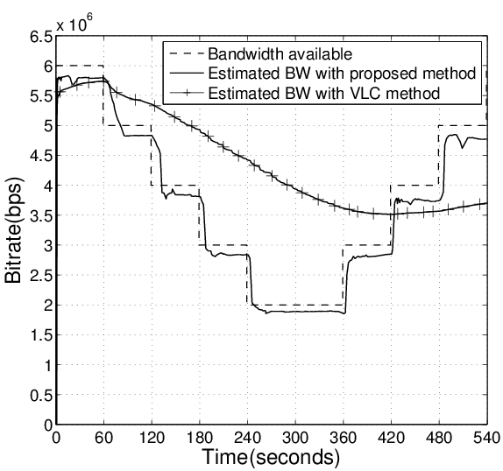
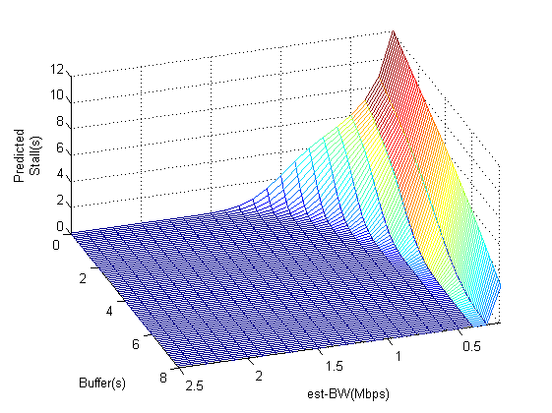
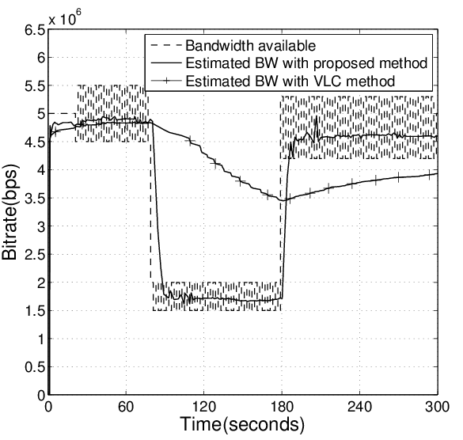
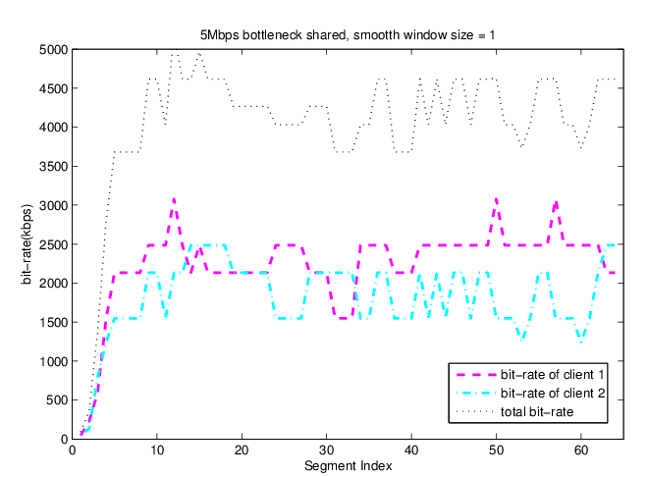
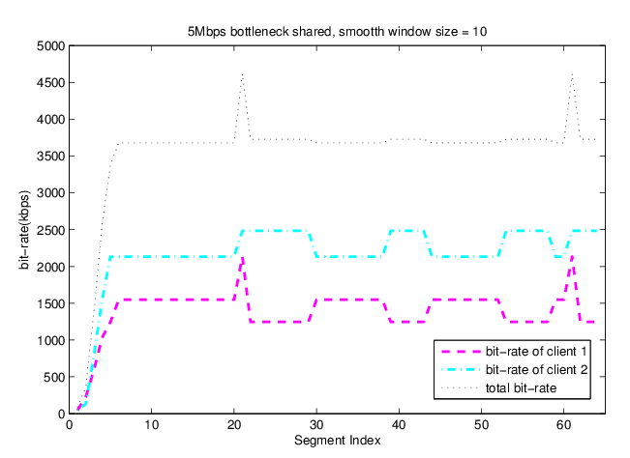
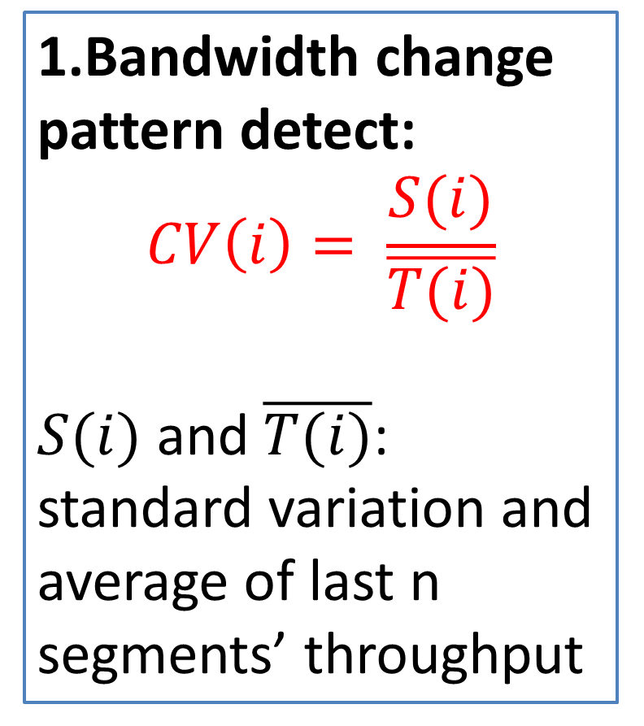
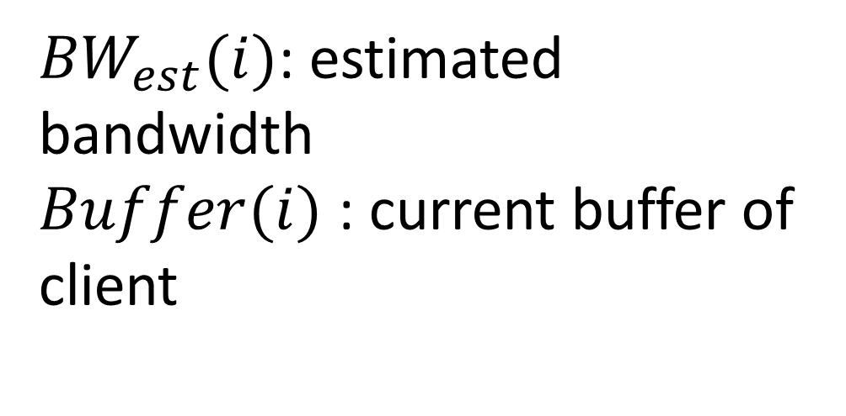
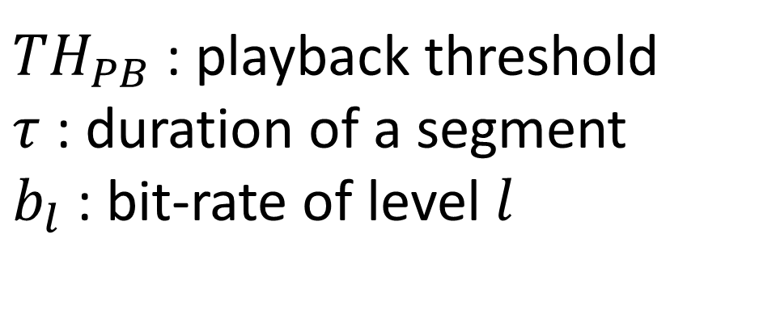
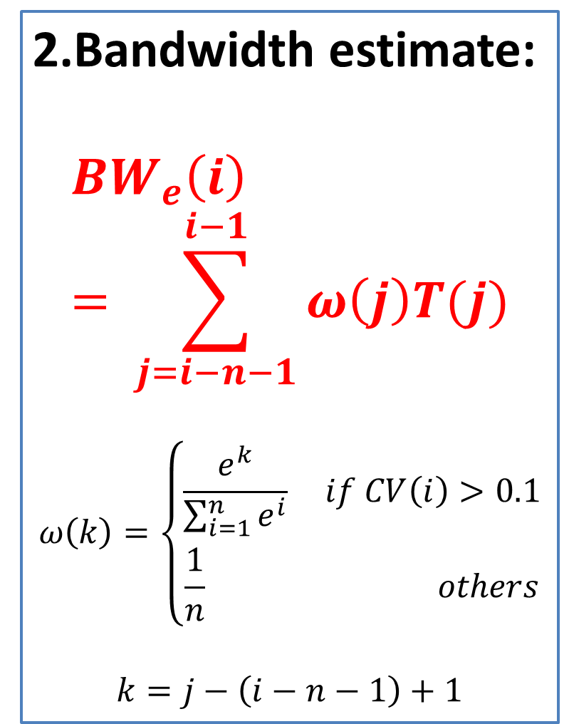
BUPT-QUALCOMM Joint Research Program
DASH User Experience Improvement Study
Lin Qi, Shen Hui, Li Yuchen, and Liu Yitong
Beijing university of Posts and Telecommunications, China
Email: liuyitong@bupt.edu.cn
Summary
QoE-based bitrate adaptation algorithm in DASH service
Predict stall duration and probability
Utilize a real-time QoE model with stall prediction in bitrate adaptation algorithm
Select bitrate level to maximize user experience
Propose bandwidth estimation in DASH service
Consider 2 typical bandwidth variation scenarios
Response quickly for long-term variation and keep stable for short-term fluctuation
Research on the performance of bitrate adaptation for multi-user DASH(on going)
Overall Optimization^{[1]} : theoretical upper bound under a given bandwidth variation scenario.
Stall prediction of DASH service
Bandwidth estimation
Segment size (bytes) obeys Gaussian Distribution ^{[1]}
Stall probability
Stall duration
Predict real-time QoE impairment [2]due to stall via (1)
2 typical scenario
Long-term variation within wide range—response quickly
Short-term fluctuation within narrow band—keep stable
${TH}_{PB}$ : playback threshold
$τ$ : duration of a segment
$b_{l}$ : bit-rate of level $l$
1.Bandwidth change pattern detect:
$$CV\left(i\right)= \frac{S(i)}{\overline{T(i)}}$$
$S(i)$ and $\overline{T(i)}$:
standard variation and average of last n segments’ throughput
${BW}_{est}(i)$: estimated bandwidth
$Buffer(i)$ : current buffer of client
(1)
Figure 2. Bandwidth estimation for scenario 1
2.Bandwidth estimate:
$${BW}_{e}\left(i\right)= \sum_{j=i−n−1}^{i−1}{ω\left(j\right)T(j)}$$
$$ω\left(k\right)=\left\{\begin{aligned}\frac{e^{k}}{\sum_{i=1}^{n}{e^{i}}} if CV\left(i\right)>0.1 \\ \frac{1}{n} others\end{aligned}\right.$$
$$k=j−\left(i−n−1\right)+1$$
Predicted Stall duration
τ = 2s
BW_{est}=2Mbps
b_{l}=2Mbps
QoE-based bitrate adaptation of DASH
Figure 3. Bandwidth estimation for scenario 2
Multi-users in DASH
Select bitrate level l_{selected}(i) for requesting segment i, according to:
QoS_{Net}(i) : network condition;
S(i): DASH client state(buffer length.etc);
KPI_{DASH}(i-1): previous KPIs of DASH( stall, initial delay, level variation etc.).
Analyze different bitrate adaptation algorithms
When bitrate adaptation is smoother, fairness and efficiency are less
User = 2, smooth window size = 1
Unfairness = 545.9; Utilization = 0.819
User = 2, smooth window size = 15
Unfairness = 784.3; Utilization = 0.712
Smooth window size: The number of segments which is involved in bandwidth estimation.
[1] Dmitri Jarnikov et al, "Client intelligence for adaptive streaming solutions “, 2011.
[2] Yao Liu et al,” User Experience Modeling for DASH Video” ,2013.
[3] Dongeun Suh et al, "QoE-enhanced Adaptation Algorithm over DASH for Multimedia Streaming" 2014.

